Slide 1
LOGIC CIRCUITS
EXERCISE 4

Slide 2
Problem statement
Write a Boolean function of 4 variables given by its table of values, simplify it and draw the logic circuits corresponding to all its simplified forms.

Slide 3

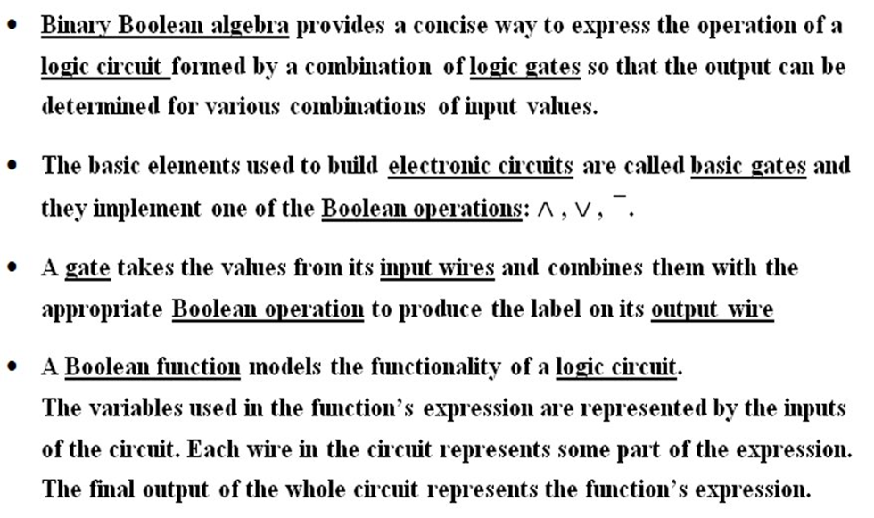
Theory

Slide 4
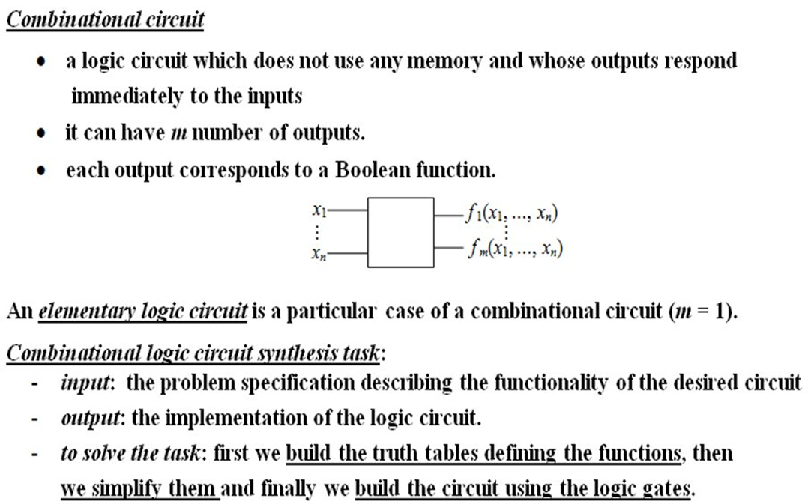

Slide 5
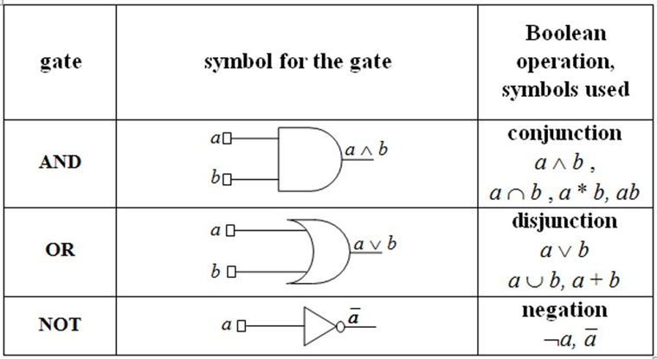
Basic gates

Slide 6
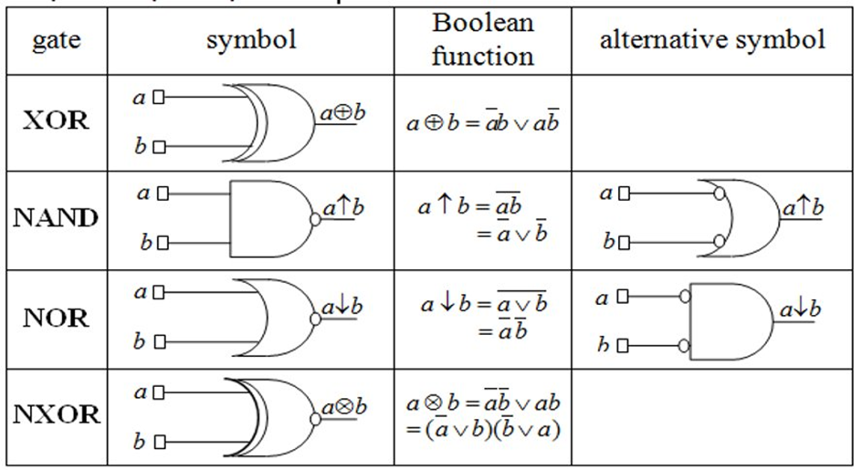
Derived Gates: XOR, NAND, NOR, NXOR

Slide 7
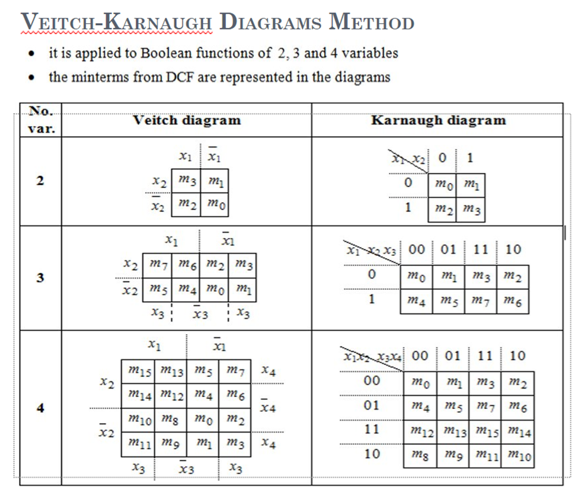

Slide 8
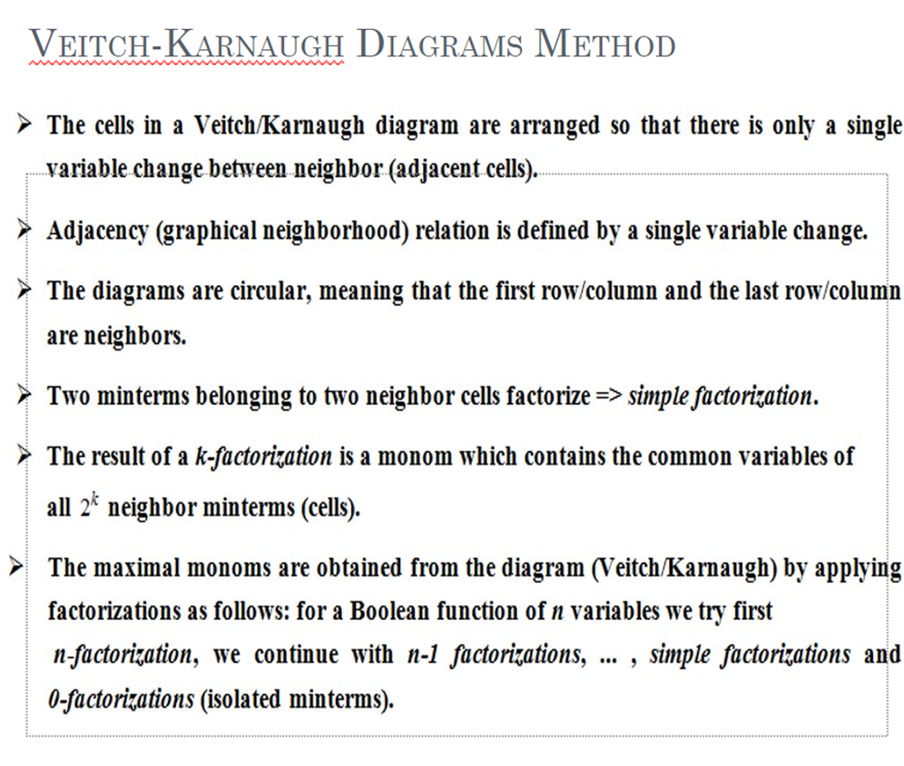

Slide 9
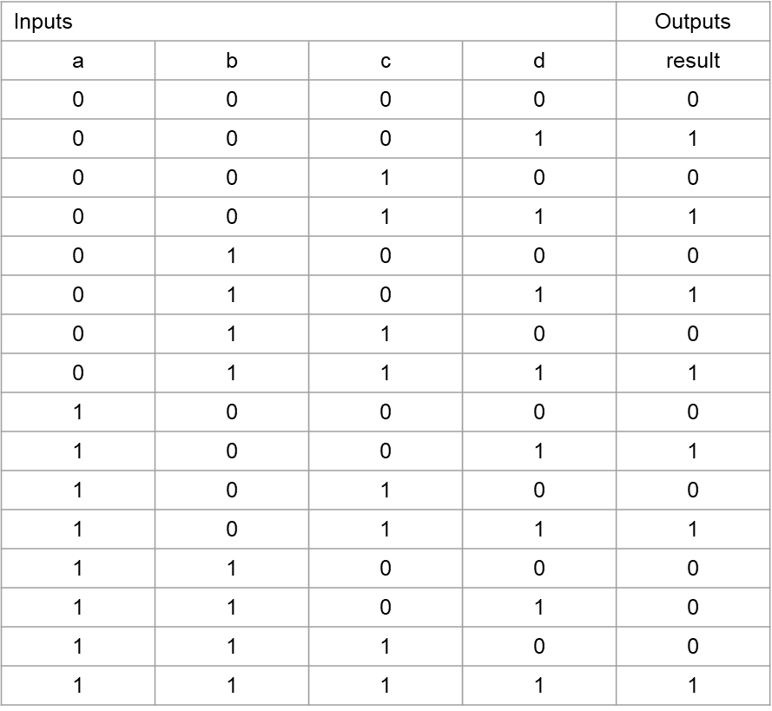

Slide 10
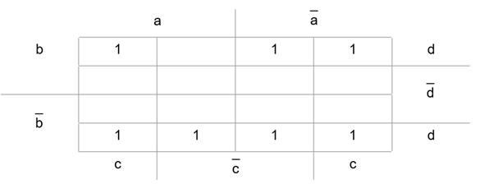
Veitch Diagram

Slide 11
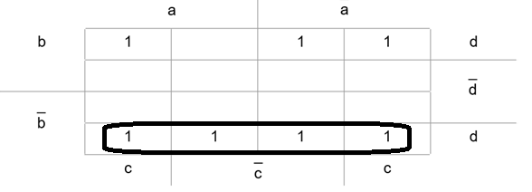
Triple factorization
_
max1 = m11 ∨ m9 ∨ m1 ∨ m3 = bd

Slide 12
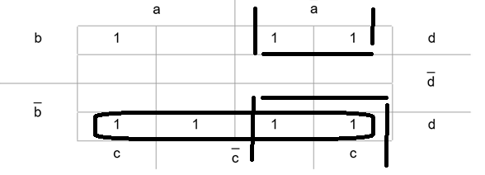
Double factorization
_
max2 = m5 ∨ m7 v m1 v m3= ad

Slide 13
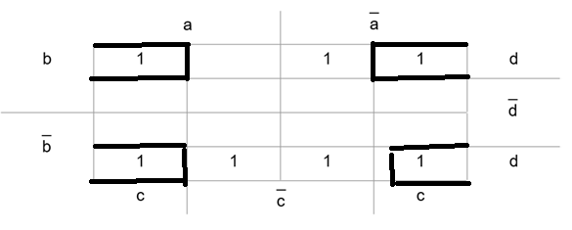
Simple factorization
max3 = m15 v m7 v m11 v m3 = cd
M(result) = {max1, max2, max3}
C(result) = {max1, max2, max3}
M(result) = C(result) => 1st case of the simplification algorithm
_ _
result(a,b,c,d) = max1 v max2 v max3 = bd v ad v cd in a disjunctive simplified form

Slide 14
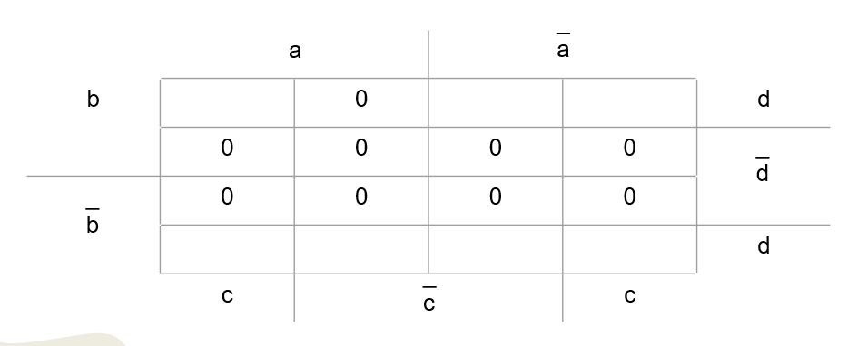
Veitch Diagram for CCF

Slide 15
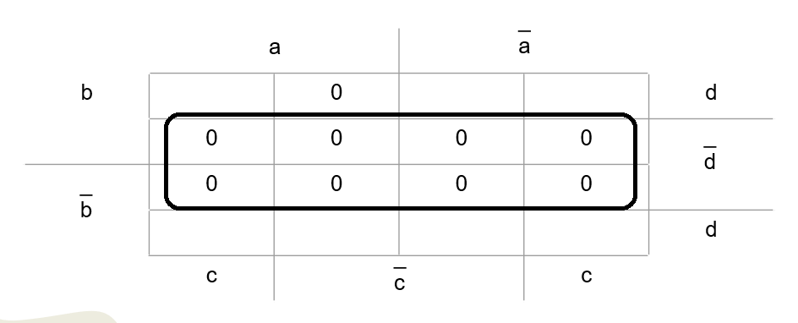
Triple factorization
_
max1_d = M14 ∧ M12 ∧ M4 ∧ M6 ∧ M10 ∧ M8 ∧ M0 ∧ M2 = d

Slide 16
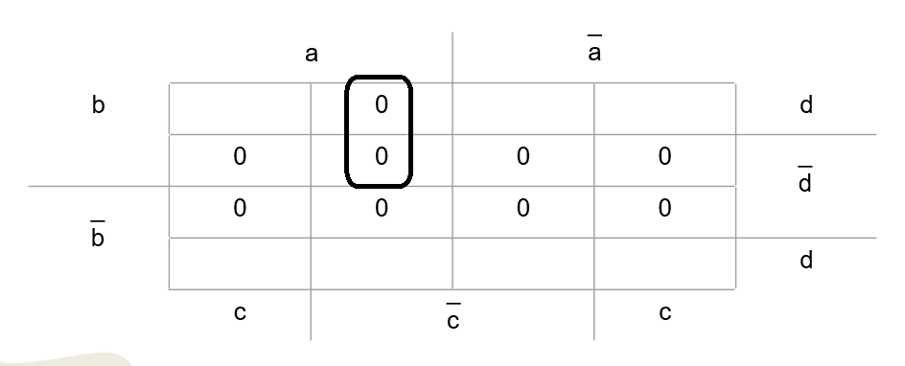
Simple factorization
_
max2_d = M13 ∧ M12 = a ∨ b ∨ c

Slide 17
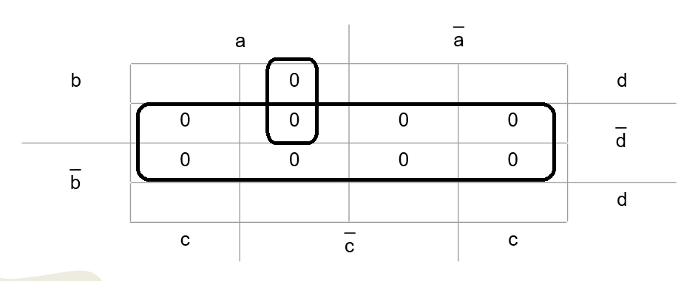
M_d(result) = {max1_d, max2_d}
C_d(result) = {max1_d, max2_d}
M_d(result) = C_d(result) => 1st case of the simplifaction algorithm
_ _
The function result(a,b,c,d) = max1_d ∧ max2_d = d ∧ ( a ∨ b ∨ c ) in a conjunctive simplified form

Slide 18
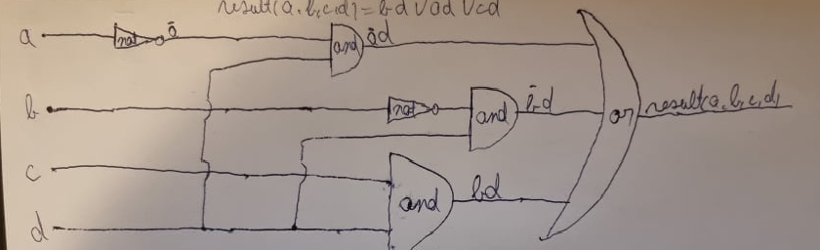
DCF Circuit

Slide 19
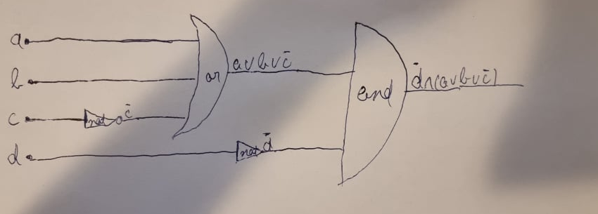
CCF Circuit

Slide 20
The end

